Slide 1
Support
And
Resistance

Slide 2
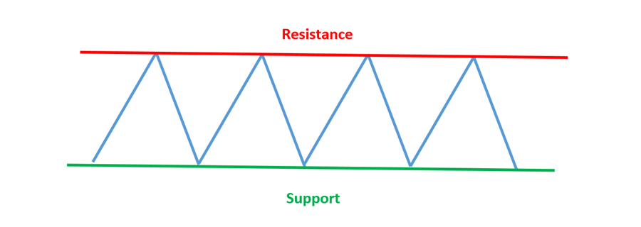
Support and Resistance
What is ‘support and resistance’?
When price rises and corrects, the peak formed is a resistance
When price declines and throws back, the trough formed is a support
Many trading strategies are based on support and resistance
Support and resistance form because of the psychology of the traders/investors
Demand is higher at the support zones
Supply is higher at the resistance zones
S&R are useful to set take positions

Slide 3
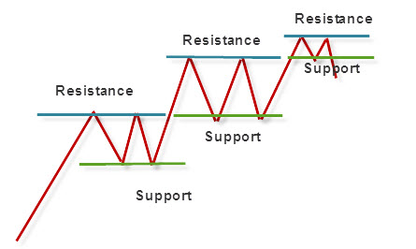
Support and Resistance

Slide 4
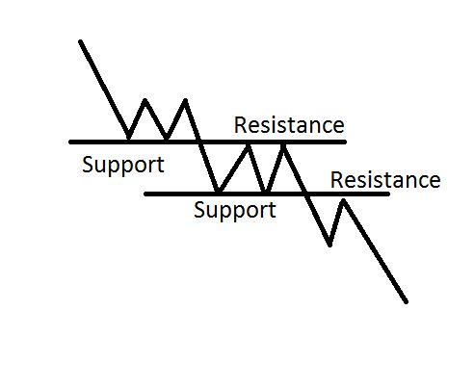
Support and Resistance

Slide 5
Why Support and Resistance are Important
Price tend to stop/pause/stall or even reverse around previous S&R levels
Could be potential buy/sell region
It is the indication of shift in demand and supply pressure
The more time S&R are tested and unable to break, the more reliable it becomes

Slide 6
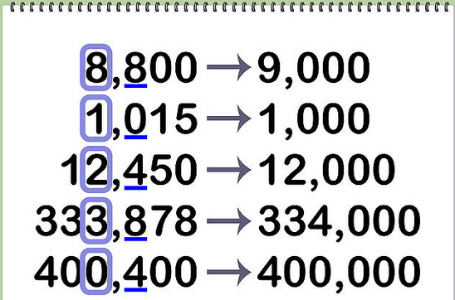
Importance of Round Figures
Human beings tend to think in terms of round figures
Round figures tend to work as a psychological barrier
Many traders/investors wish to entry/exit at these levels

Slide 7
The Basics of
Trend

Slide 8
What is a Trend?
General direction of the market
Trend is the key to profits
There would be no TA if trend didn’t exist
First step for market analysis
Trend is your friend

Slide 9
Lengths of Trends
Primary trend, Major trend
Secondary or intermediate trend
Short term trend, Minor trend, Near trend

Slide 10
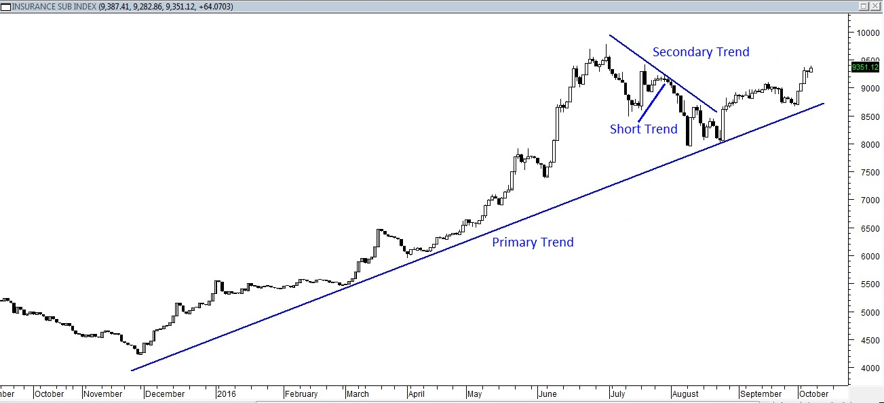
Primary Trend
Lasts for many months to several years

Slide 11
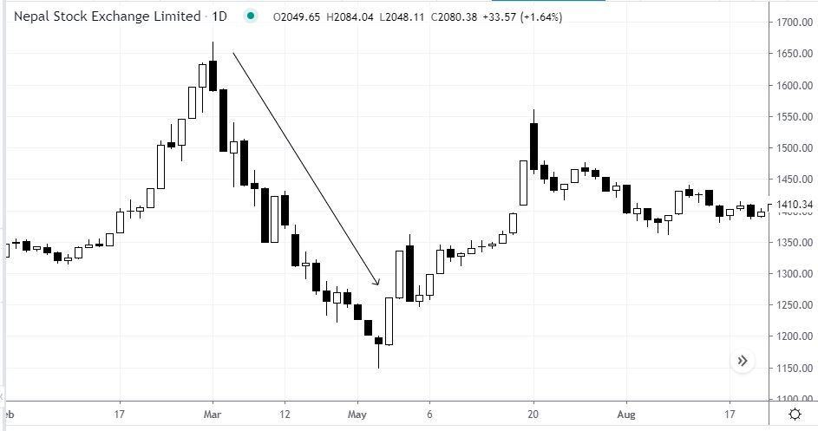
Secondary Trend
Lasts for several months
Measured in months

Slide 12
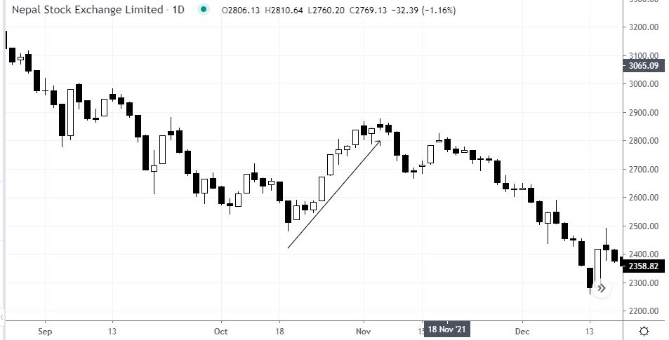
Short term trend
Lasts for not longer 2 to 3 weeks
Measured in days/weeks

Slide 13
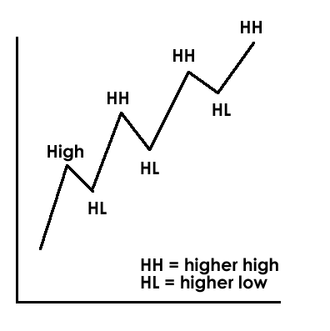
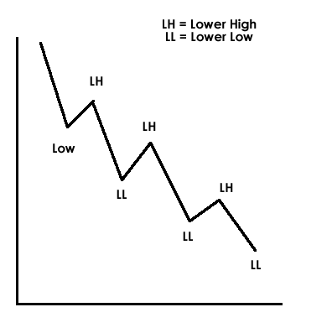
HH, HL, LH, and LL
HH= Higher high
HL= Higher low
LH= Lower high
LL= Lower low
Uptrend= Higher highs and higher lows formations
Downtrend= Lower highs and lower lows

Slide 14
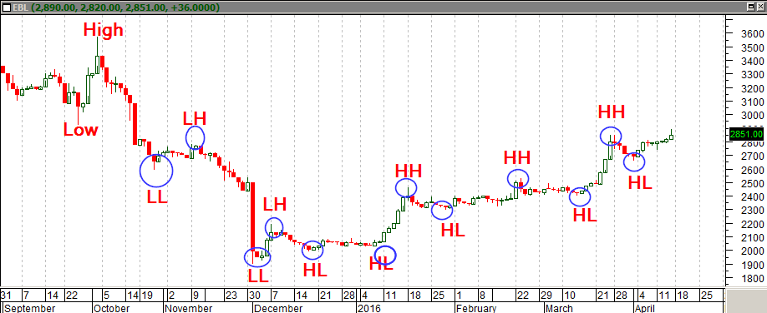
HH, HL, LH, and LL illustrated

Slide 15
Types of Market Trends
Uptrend Market
Downtrend Market
Sideways Market

Slide 16
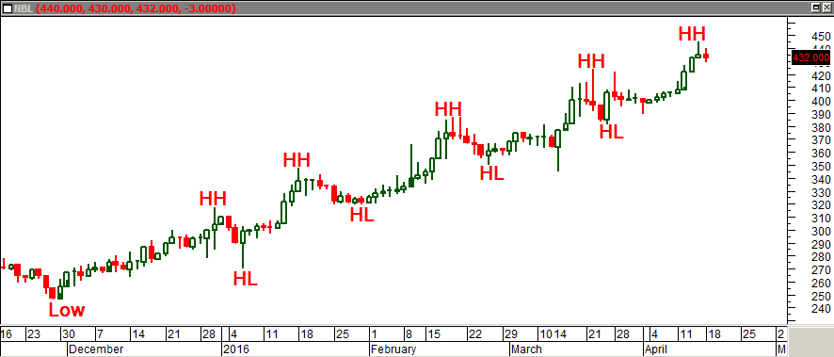
Uptrend Market
Rising Market
Formation of higher highs and higher lows
Indicates increasing demand for the stock

Slide 17
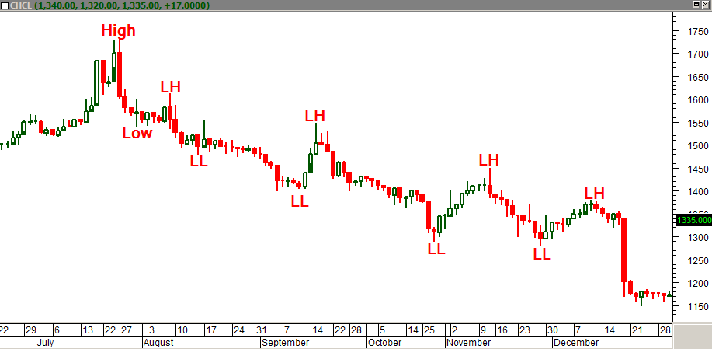
Downtrend Market
Falling Market
Formation of lower highs and lower lows
Indicates increasing supply for the stock

Slide 18
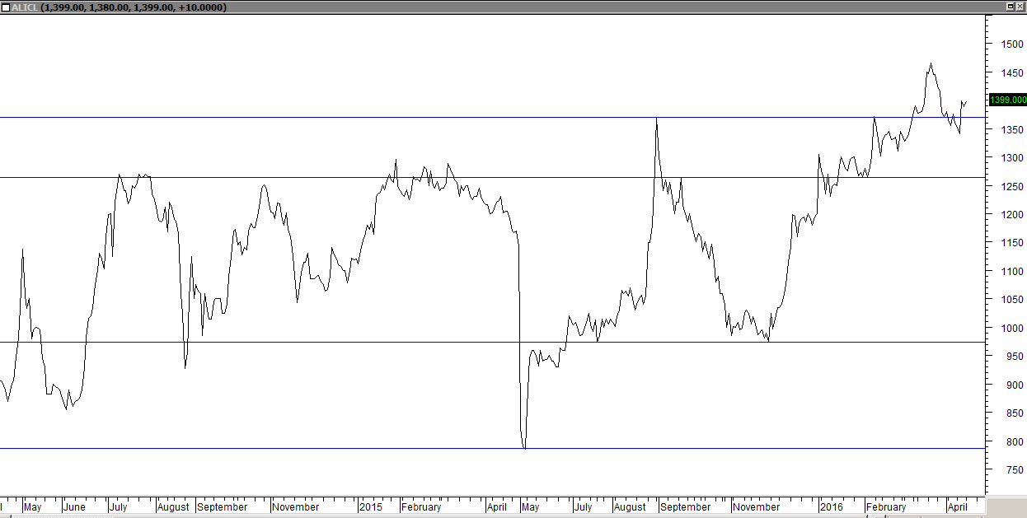
Sideways Market
No any particular direction
Certain support and resistance levels are tested repeatedly
Price fluctuates within a certain price range

Slide 19
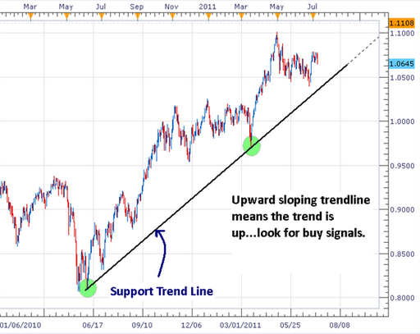
Trendline
It is a straight line
Trendline are drawn by joining two support or two resistance
In an uptrend market, trendline is drawn by joining two or more support
In a downtrend market, trendline is drawn by joining two or more resistance
Trendline is drawn to determine the potential reversal regions

Slide 20
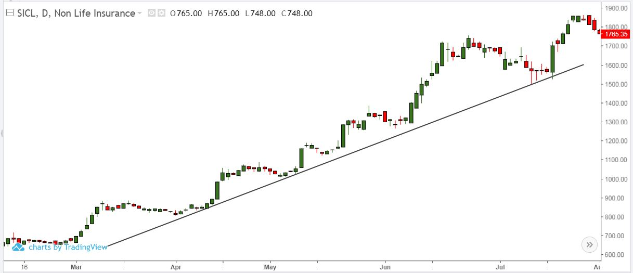
Using Trendline in uptrend market

Slide 21
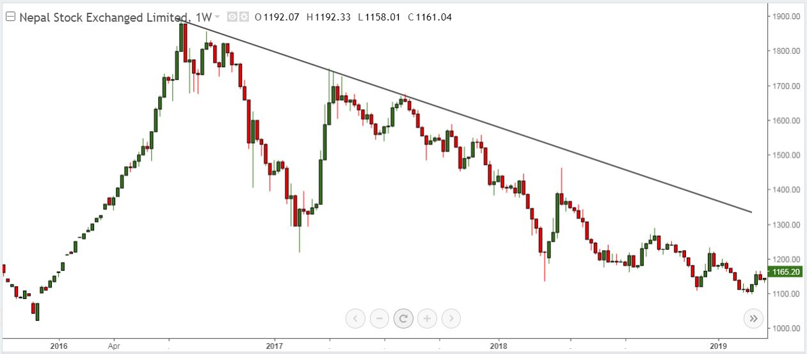
Using Trendline in downtrend market

Slide 22
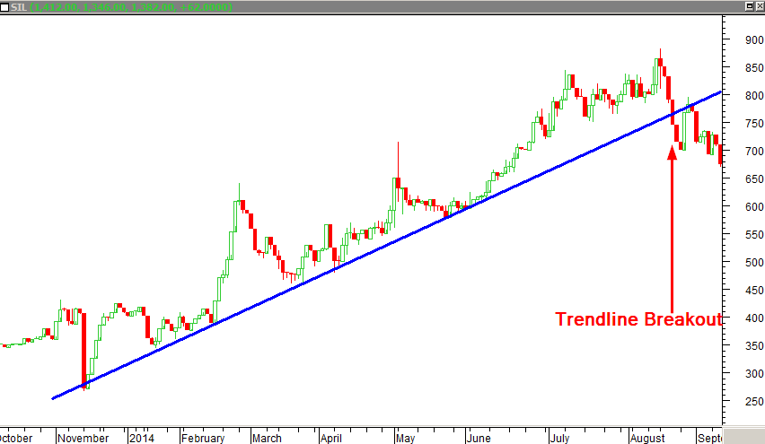
Breakout

Slide 23
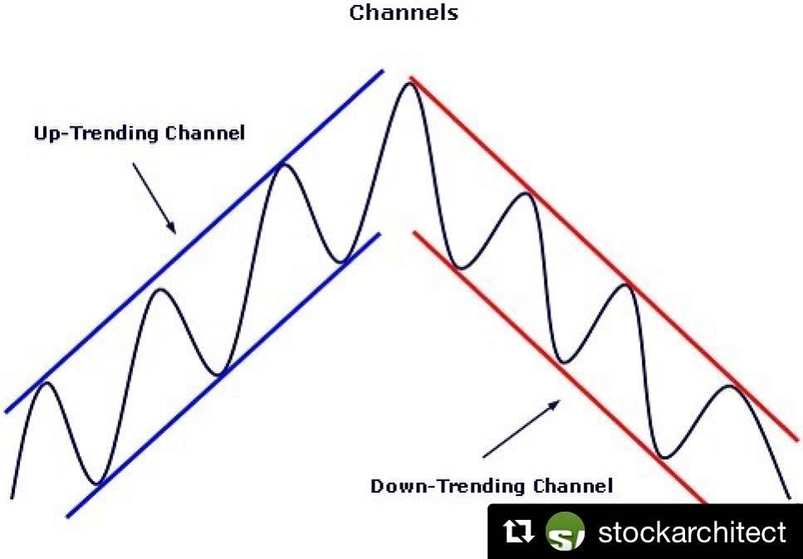
Channels
Channels are mostly used in trending markets
Price tend to fluctuate within the range of the channel
Breakout of the channel could mean that the trend will continue/reverse
Channels signal possible entry/exit zones
Channels are two parallel trendline

